Slide 1
UE20CS312- DATA ANALYTICS
PROJECT

Slide 2
Investigation Of Road Accident Severity per Vehicle Type

Slide 3



TEAM PRESENTATION
SNEHA SARAVANAN
PES1UG20CS721
ROHITH NEERAJE
PES1UG20CS357
SAHANA S
PES1UG20CS723

Slide 4
TABLE OF CONTENTS
Aim of The Project
The main idea behind the project.
Feasibility of the Project
Relevance and the important features of the project.
Dataset to Be Used
The potential dataset to be used.
Approach & Evaluation
Approach used in the model and the evaluation metrics
Peer Review
The questions asked by peers regarding the project report

Slide 5
AIM OF THE PROJECT
The primary goal of this project is to use statistical analysis methods such as multiple linear regression to gain insights into the road accidents depending on the vehicle type, state and their injury measure. Using data obtained from the government website a comparison between state groups is performed using the standardized regression coefficients to check for contrasts between different types of vehicles. Analysis of these variables on a macroeconomic scale is imperative in order to gain insight on the current scenario, and to see if improvements in any sector would lead to monumental change and growth overall.The aim of this paper is to identify the major vehicles that cause fatal road accidents to two wheeler vehicles and 4 wheeler vehicles.
Keywords—Road Traffic Accidents (RTAs), Traffic Safety, Traffic Analysis, Visualization

Slide 6
FEASIBILITY OF THE PROJECT
The project is based on the recent increase in accidents in India. These accidents cause immense loss of human lives and social and economic losses. By analysing these accident trends and their severity , we hope to provide statistics to the Government that would help them implement amicable solutions to prevent the occurrence of such accidents.

Slide 7
CHOICE OF DATASET
This data set was used as it was authenticated by the government.

Slide 8
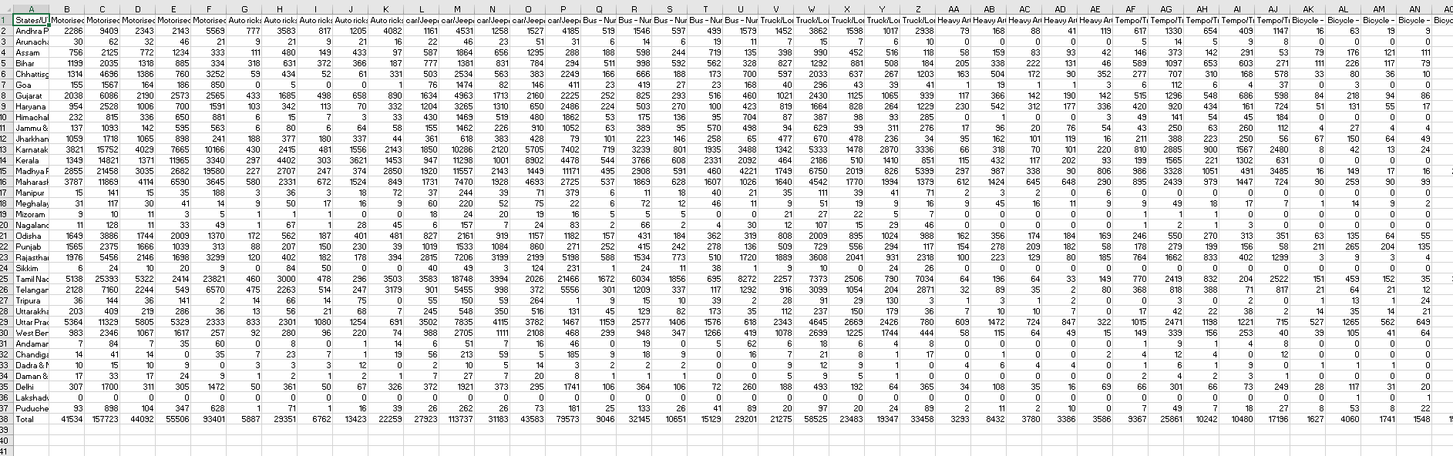
DATASET USED

Slide 9
APPROACH USED
1

Slide 10
The approach used was Multiple Linear Regression.
The first is the ability to determine the relative influence of one or more predictor variables to the criterion value
The second advantage is the ability to identify outliers, or anomalies.

Slide 11
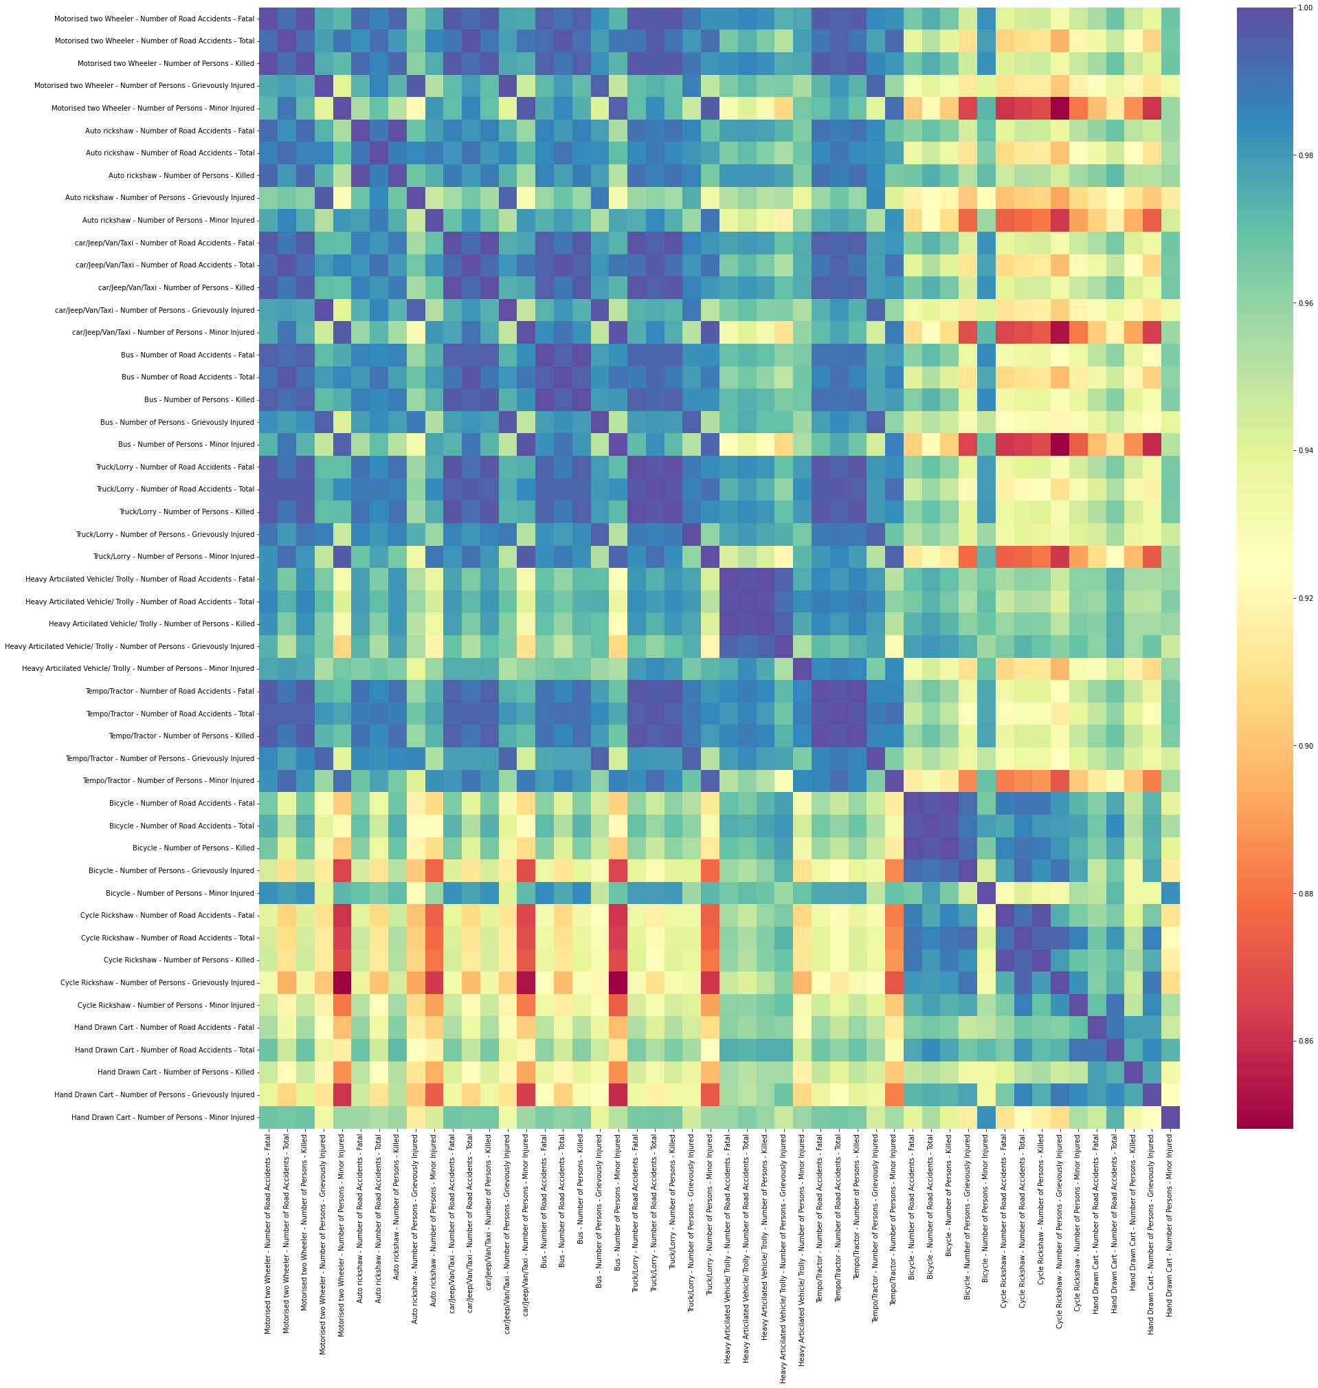

Slide 12
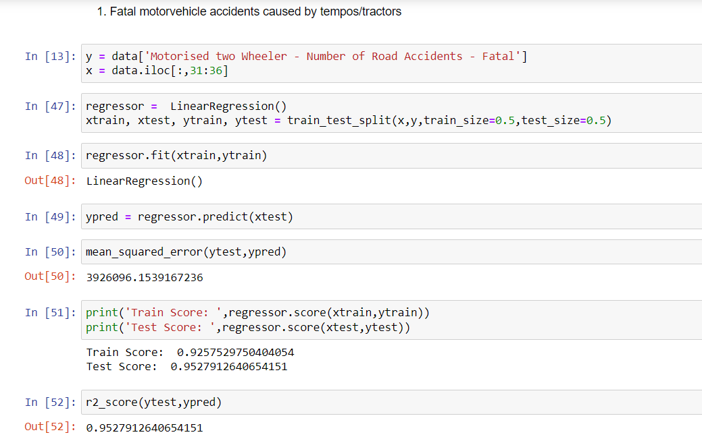

Slide 13
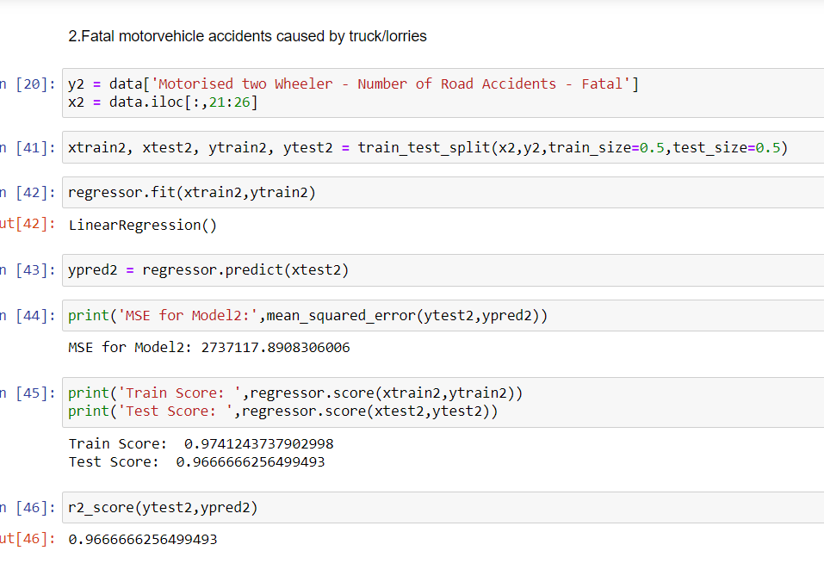

Slide 14
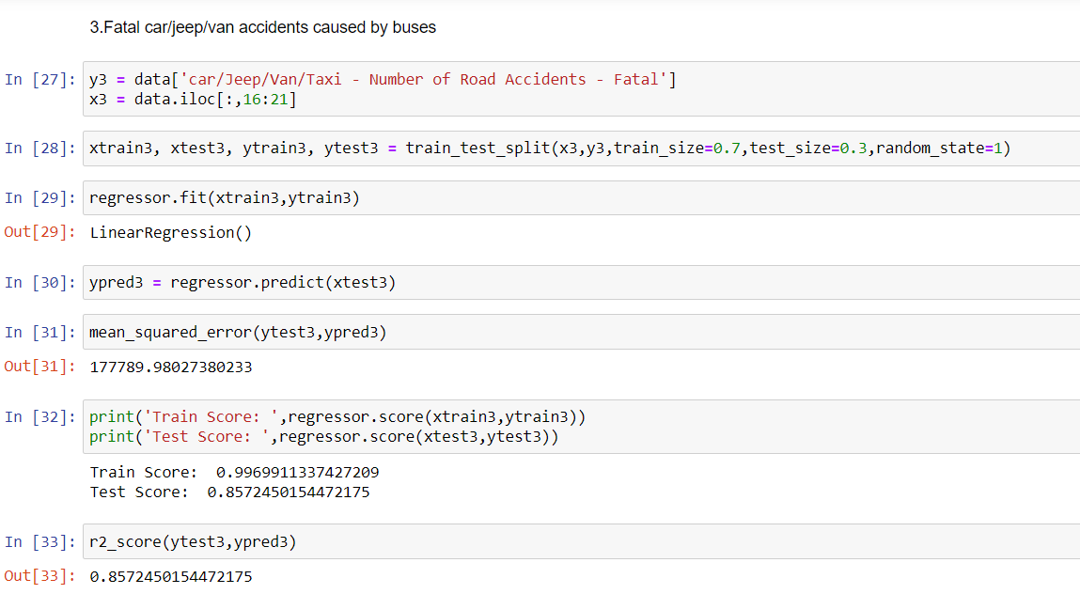

Slide 15
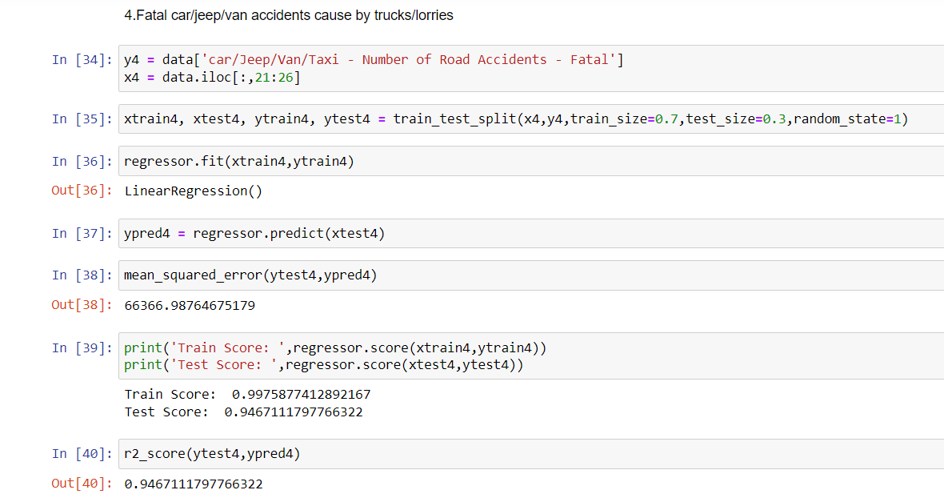

Slide 16
EVALUATION OF THE MODEL
3

Slide 17
Each model was evaluated using the regressor.score function. The MSE values were also calculated and the R2 score was found.

Slide 18



For Fatal motor vehicle accidents that are caused by tempos/tractors , the scores were as follows:

Slide 19



For Fatal motor vehicle accidents caused by truck/lorries the accuracy scores were -

Slide 20



For Fatal car/jeep/van accidents caused by buses

Slide 21



For Fatal car/jeep/van accidents caused by trucks/lorries

Slide 22
PEER REVIEW
2

Slide 23
1.Why this project?
This project was chosen as in recent times the number of traffic accident has been increasing and we wanted to figure out the causes, hence reducing the number of accidents
2.Why this model ?
The approach used was Multiple Linear Regression.
The first is the ability to determine the relative influence of one or more predictor variables to the criterion value
The second advantage is the ability to identify outliers, or anomalies.
3.Why only cars and bikes?
According to a survey in 2021,most fatal accidents on the road have occurred to two wheelers and cars/jeeps/vans.
4.State with the most bike and car accidents and how did you find it out?
Tamil Nadu, it was found using a bar graph discussed above.
Peer Review Team,
PES1UG20CS502- Vikas C,
PES1UG20CS601- Tanmai N

Slide 24
THANKS!

